Slide 1

Sequoro

Slide 2
TEAM MEMBERS
Anjana S
Ashly Chacko
Jithu R Jacob
Radhika P R

Slide 3
1. INTRODUCTION
Sequoro is an Open Authentication system with two step QR based authentication
It provides a new cost effective method for two step user authentication
It is resistant against several attacks including key loggers
Sequoro OAuth system could be easily implemented in any existing website

Slide 4
2. PROBLEM DEFINITION
Existing system of OTP’s relies on an external devices , SMS or independent apps.
OTP’s send as SMS are prone to network delays and are not accessible in areas with no network coverage.
They are costly for small companies to implement.
The proposed system helps us to provide an economic and secure solution.

Slide 5
3. OBJECTIVES
Sequoro aims at providing a universal economical way to provide secure login to websites
It is secure against common password stealing attacks including key loggers

Slide 6
4. REQUIREMENTS
4.1 SOFTWARE REQUIREMENTS
Operating system : Android
Client Side : Android 4.3 or higher
Server Side : JSP

Slide 7
4.2 HARDWARE REQUIREMENTS
Processor : 1.6 GHz or faster processor
Memory size : 1GB RAM
Storage : 10 GB Hard Disk
Keyboard : Virtual keyboard with 102 keys
Device : Android Mobile with 2 MP or higher camera

Slide 8
5. MODULES
REGISTRATION
Username, password and email address are collected from users and companies
Companies can enter their website details
User can select protocol and specify secondary password
APPLICATION CONFIGURATION
Verified user can only use the system
RSA 2048 bit key pair generation
Public key is uploaded to server
Private key is saved to local storage

Slide 9
QR CODE GENERATION
User is verified and protocol selected
For protocol 1 OTP is generated, encrypted and encoded to QR code
For protocol 2 random keyboard layout is created ,encrypted and encoded to QR code
LOGIN PROCEDURE
User is verified , QR code is generated and displayed
User scans the QR Code
For protocol 1 OTP is decoded from QR code, decrypted and displayed
For protocol 2 Keyboard layout is decoded from QR code ,decrypted and displayed

Slide 10
6. VISUAL AUTHENTICATION PROTOCOLS
There are several visual authentication protocols introduced to ensure better security
Most of them are not user friendly and can not be used by a user with non technical background
We introduce two novel protocols
Authentication With Random Strings (Protocol 1)
An Authentication Protocol with Password and Randomized Onscreen Keyboard (Protocol 2)
Notes:
IN PROTOCOL 1 WE USE A SIMPLE OTP SYSTEM THE USR NEEDNOT REMEMBER A PWD
IN PROTOCOL 2 THE USR NEED TO REMEMBER A PWD AND THIS WOULD BE ENTERD USING A RANDOSD VIRT KEYBD

Slide 11
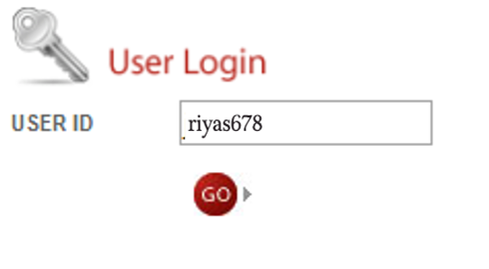
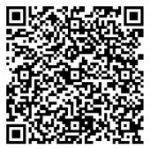
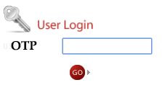
Protocol 1
User provides login details
Server verifies the details ,create an OTP and encrypt it with users public key and sign it
Server encode this into a QR code and sends to user
User needs to decrypt the OTP from QR code

Slide 12
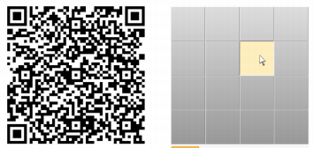
Protocol 2
User provides login details
Server verifies the details ,create a random keyboard layout and encrypt it with users public key and sign it
Server encode this into a QR code and sends to user
User needs to decrypt the Layout from QR code
User uses this random layout to enter his secondary password

Slide 13
7. DATA FLOW DIAGRAM
LEVEL 0
SEQUORO
USER
REQUEST
RESPONSE
USER

Slide 14
LEVEL 1
CMPNYOPNS
2.0
REGISTERD COMPANY
CHECK
USER
1.0
USER
OPNS
3.0
REGISTRD USER
INFO
USER
NOT REGISTERED
EXTERNAL LOGIN
REGISTR
4.0
CHECK LOGIN
5.0

Slide 15
LEVEL 2 DFD FOR PROCESS 2.0
CMPNY OPNS
ADD SITE
COMPANY
INFO
SITE URL
WEBSITE DETAILS

Slide 16
LEVEL 2 DFD FOR PROCESS 3.0
FORGT PASWD
3.1
FORGOT PWD
USER OPNS
APP
CONFG
3.2
USER
INFO
APP CONFIG
PROTOCOL
PROTCL SELCTN3.3
SELECT PRTCOL
SELECT
USER DETAILS

Slide 17
LEVEL 2 DFD PROCESS 4.0
CMPNY
COMPNY DETAILS
USERNAME,EMAIL,PWD
REGISTR
USER
USERNAME,EMAIL,PWD
USER
USER DETAILS

Slide 18
OTP DETAILS
LEVEL 2 DFD PROCESS 5.0
LOGIN PRCD 1 5.1
GENRTE QR CODE
LOGIN
PROTCL 1
EXTERNL LOGIN
USER
USERNAME,PWD
PROTCL 2
GNRT QR, RANDM KYBD
LOGIN PRCD 2 5.2
LOGIN
USER DETAILS
OTP DETAILS

Slide 19
LEVEL 3 DFD FOR PROCESS 3.1
FORGT PASW
SEND RECVRY MAIL
USER
INFO
HASH(RAND)
EMAIL,HASH(RAND)
USER DETAILS

Slide 20
LEVEL 3 DFD FOR PROCESS 3.2
APP CONFG
GENRT RSA KEY PAIR
USER
USERNME, PASW
VERIFIED
PRIVATE KEY
LOCAL STORAGE
VERIFY
PUBLIC KEY
USER DETAILS
USER DETAILS

Slide 21
LEVEL 3 DFD FOR PROCESS 5.1
SHOW QR CODE
DECDE
DECRPT AND SHOW OTP
AUTH
USER
VERIFIED
SCAN QR
SHA1(OTP)
QRENCODE(RSA(OTP))
PRIVATE KEY
SHA1(OTP)
OTP
LOCAL STORAGE
OTP

Slide 22
LEVEL 3 DFD FOR PROCESS 5.2
SHOW QR CODE
DECDE
DECRPT AND SHOW KYBD
AUTH
USER
VERIFIED
SCAN QR
KEYS
QRENCODE(RSA(KEYBD))
PRIVATE KEY
SHA1(SPWD)
OTP
LOCAL STORAGE
USER DETAILS

Slide 23
USER DETAILS
8.TABLES
ATTRIBUTE | TYPE | CONSTRAINTS
id | Int | Auto increment
username | varchar(30) | Not null
pwd | varchar(30) | Not null
email | varchar(30) | Not null
public_key | varchar(500) | null
protocol | int | Default 0
Secondary_password | Varchar(30) | null

Slide 24
COMPANY DETAILS
ATTRIBUTE | TYPE | CONSTRAINTS
id | Int | Auto increment
c_username | Varchar(30) | Not null
Pwd | Varchar(30) | Not null
Email | Varchar(50) | Not null

Slide 25
OTP
ATTRIBUTE | TYPE | CONSTRAINTS
id | int | Auto increment
username | Varchar(30) | Not null
C_username | Varchar(30) | Not null
website | Varchar(150) | Not null
OTP_hash | Varchar(50) | Null
time | time | Not null
used | int | Default 0
sessionid | Varchar(150) | Not null
Randomkybd_valuepair | Varchar(150) | null

Slide 26
WEBSITE DETAILS
ATTRIBUTE | TYPE | CONSTRAINTS
id | int | Auto increment
C_username | Varchar(30) | Not null
Website url | Varchar(200) | Not null

Slide 27
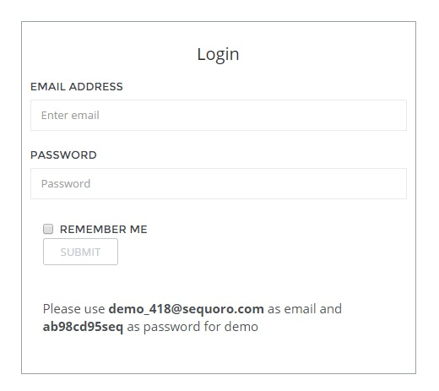
9. SCREENSHOTS

Slide 28
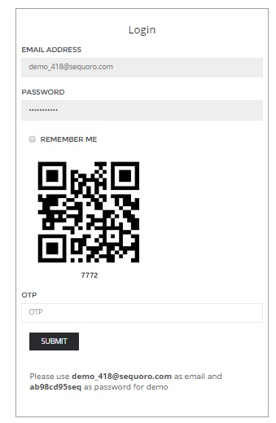

Slide 29
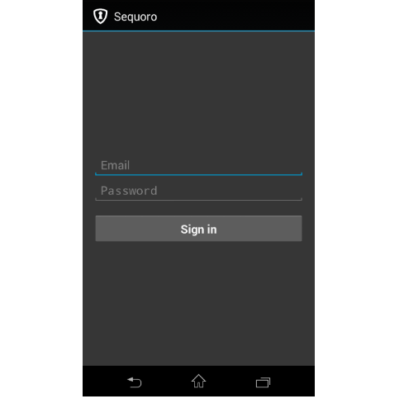
ANDROID APP INTERFACE

Slide 30
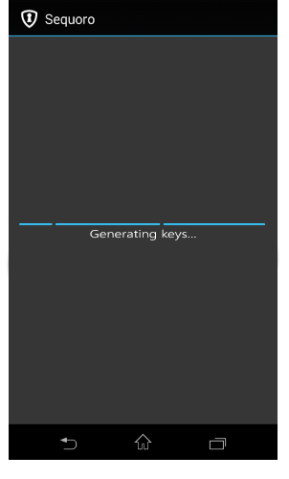

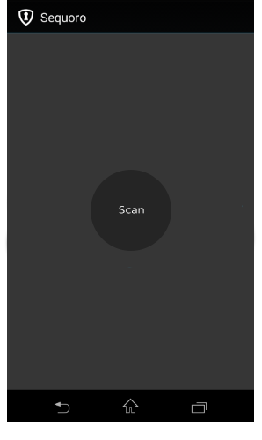

Slide 31
10.IMPLEMENTATION STATUS
COMPLETED
QR Code encoding and decoding
Base 64 encoding and decoding
JSON based Client Server Communication
RSA Key Generation, Encryption and decryption
Protocol 1
INCOMPLETE
Protocol 2
Signature Verification
GUI for user interaction

Slide 32
11. CONCLUSION
Sequoro provides a universal, economic solution for secure login to websites
It is secure against common password stealing attacks including key loggers.
Sequoro does not need any network coverage. It only needs a smartphone with 2MP camera
By the use of cryptographic techniques passwords are saved securely.

Slide 33
12.REFERENCES
[1] Google authenticator. http://code.google.com/p/google- authenticator/.
[2] Rsa securid. http://www.emc.com/security/rsa-securid.html
[3] S. Goldwasser, S. Micali, and R. L. Rivest. A digital signature scheme secure against adaptive chosen-message attacks. SIAM Journal, 1988.
[4] Google. Android. http://www.android.com/, 2011.
[5] R. Housley. RFC3686: Using Advanced Encryption Standard (AES)
counter mode with ipsec encapsulating security payload (ESP).

Slide 34
Thank You

